Slide 1

EXECUTIVE COUNCIL OF THE
PRESIDENTS COUNCIL
June 19, 2026

Slide 2
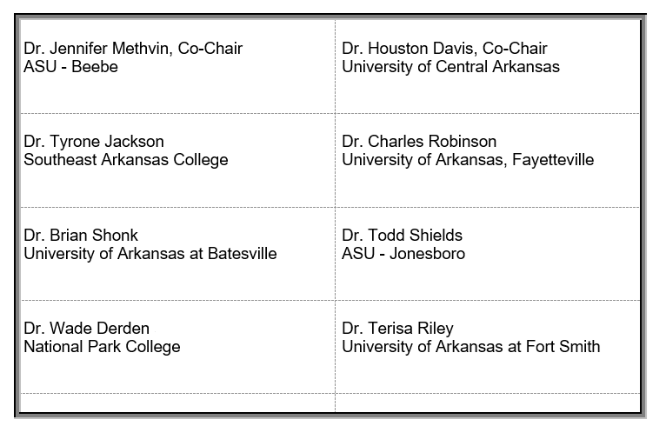
Council Members

Slide 3
Approval of Minutes
April 4, 2026

Slide 4

Arkansas
Professional Skills Training Funding Model Overview
Executive Council of the Presidents Council Meeting
June 19, 2026
Notes:
1 min

Slide 5
ACCESS
(Act 341 of the 2025 Arkansas Legislative Session)
SECTION 55. Arkansas Code § 6-61-234 is amended to read as follows:
(a)(3)
(A) The Division of Higher Education may promulgate rules to implement a funding formula to support noncredit programs at a state-supported institution of higher education.
(B) Funding for a noncredit program may come from the following:
(i) General revenues authorized by law; and
(ii) Any other funds as provided by law.
(C) The Division of Higher Education shall consult with the Governor's Workforce Cabinet during development of the funding formula for the noncredit programs under subdivision (a)(3)(A) of this section.
Notes:
Mason

Slide 6
Dr. Chris Heigle | Arkansas Northeastern College | President
Eric Atchison | Arkansas State University System | Vice President for Strategic Research
Dr. Steve Rook | Arkansas State University Three Rivers | Chancellor
Dr. Chuck Argo | National Park College | Vice President for Academic Affairs
Dr. Dennis Rittle | Northwest Arkansas Community College | President
Dr. Stephanie Tulley Dartez | South Arkansas College | President
Dr. Tara Dryer | University of Arkansas- Fayetteville | Assistant Vice Provost for Workforce Development
Kendall Ross | University of Arkansas- Fort Smith | Associate Vice Chancellor Economic & Workforce Development
Dr. Summer DeProw | University of Arkansas Pulaski Technical College | Chancellor
Chris Thomason | University of Arkansas System | Vice President for Strategic and Community College Partnerships
Dr. Ken Warden | Arkansas Division of Higher Education | Commissioner
Mason Campbell | Arkansas Division of Higher Education | Chief Academic Officer
Nick Fuller | Arkansas Division of Higher Education | Assistant Commissioner of Finance
Sonia Hazelwood | Arkansas Division of Higher Education | Chief Data Officer
Rachel Lewis | Arkansas Division of Higher Education | AHEIS Program Manager
Dr. Tina Moore | Arkansas Division of Higher Education | Director of Workforce Development

Slide 7
ADHE
Professional Skills Training
Non-credit postsecondary courses that develop or enhance occupational, technical, and/or durable skills of individuals – whether employed, underemployed, or unemployed – to meet the needs of employers and/or increase individual opportunity in the labor market. Courses may include methods such as lecture, workshop, customized training, apprenticeship, etc. While these courses carry no institutional credit applicable toward a degree, diploma, or certificate, the competencies and skills attained through Professional Skills Training could apply toward a prior learning credit.

Slide 8
Professional Skills Training
Funding Model
Funding amount and source TBD
Pro-rata, in arrears (proportional, for past period of performance)
Future potential for ROI metric, but not initially

Slide 9

Professional Skills Training
Funding Model Timeline
PST Funding Model Workgroup
PST Funding Model in Effect
PST Funding Paid to IHE
Spring 2026
AY 27
July 2026
Sept/Oct 2027
Spring 2028
AHECB Approval
PST Data Reporting for AY 27
*AY 27: 7/1/26-6/30/27

Slide 10
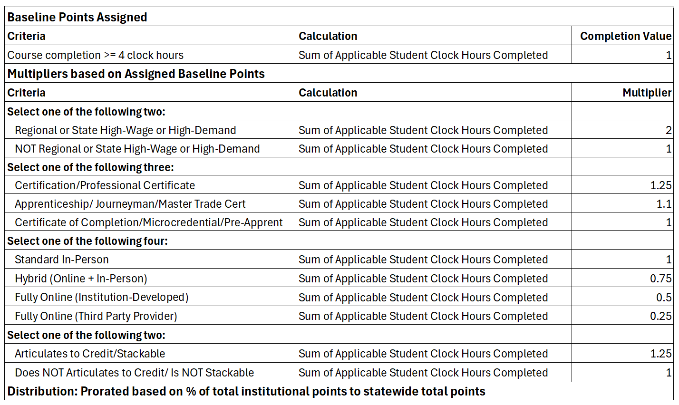

Slide 11
 |  | 40 clock hour MIG Welding, H2, Certification, In-person, Articulates/ Stackable | 40 clock hour TIG Welding, H2, Certification, In-person, NOT Articulates/ Stackable | 80 clock hour Health IT, H2, Certificate of Completion, Hybrid, Articulates/ Stackable | 80 clock hour Microsoft OS, NOT H2, Certificate of Completion, Online/3rd PP, NOT Articulates/ Stackable | 3 clock hour Leadership Workshop (other criteria does not apply due to being less than 4 hours)
Course completion >= 4 clock hours | 1 | 40 | 40 | 80 | 80 | 0
Criteria | Multiplier
Select one of the following two:
Regional or State High-Wage or High-Demand | 2 | 40x2=80 | 40x2=80 | 80x2=160
NOT Regional or State High-Wage or High-Demand | 1 |  |  |  | 80x1=80
Select one of the following three:
Certification/Professional Certificate | 1.25 | 40x1.25=50 | 40x1.25=50
Apprenticeship/ Journeyman/Master Trade Cert | 1.1
Certificate of Completion/ Microcredential/Pre-Apprent | 1 |  |  | 80x1=80 | 80x1=80
Select one of the following four:
Standard In-Person | 1 | 40X1=40 | 40X1=40
Hybrid (Online + In-Person) | 0.75 |  |  | 80x0.75=60
Fully Online (Institution-Developed) | 0.5
Fully Online (Third Party Provider) | 0.25 |  |  |  | 80x0.25=20
Select one of the following two:
Articulates to Credit/Stackable | 1.25 | 40x1.25=40 |  | 80x1.25=100
Does NOT Articulates to Credit/ Is NOT Stackable | 1 |  | 40X1=40 |  | 80x1=80
 | TOTAL | 260 | 250 | 480 | 340 | 0

Slide 12
PST Funding Model Results Using AY25 Data
SSN Optional
SSN Required
Quartile | % of Funding Range | 4-Year | 2-Year | Funding Range | Funding Total
Lower Quartile | 0.01% - 0.53% | 1 | 6 | $1,737 - $80,105 | $135,348
Second Quartile | 0.58% - 1.48% | 3 | 4 | $86,745 - $222,068 | $1,219,985
Third Quartile | 1.61% - 3.14% | 1 | 6 | $242,117 - $470,593 | $2,697,038
Upper Quartile | 3.66% - 24.89% | 1 | 6 | $549,671 - $3,732,842 | $10,947,628
Quartile | % of Funding Range | 4-Year | 2-Year | Funding Range | Funding Total
Lower Quartile | 0.00% - 0.12% | 1 | 6 | $0 - $17,333 | $54,743
Second Quartile | 0.47% - 1.80% | 3 | 4 | $70,600 - $269,603 | $1,091,242
Third Quartile | 2.05% - 3.30% | 2 | 5 | $308,116 - $495,282 | $2,875,959
Upper Quartile | 3.58% - 25.30% | 0 | 7 | $537,245 - $3,795,571 | $10,978,057

Slide 13
ANY QUESTIONS?

Slide 14


Slide 15
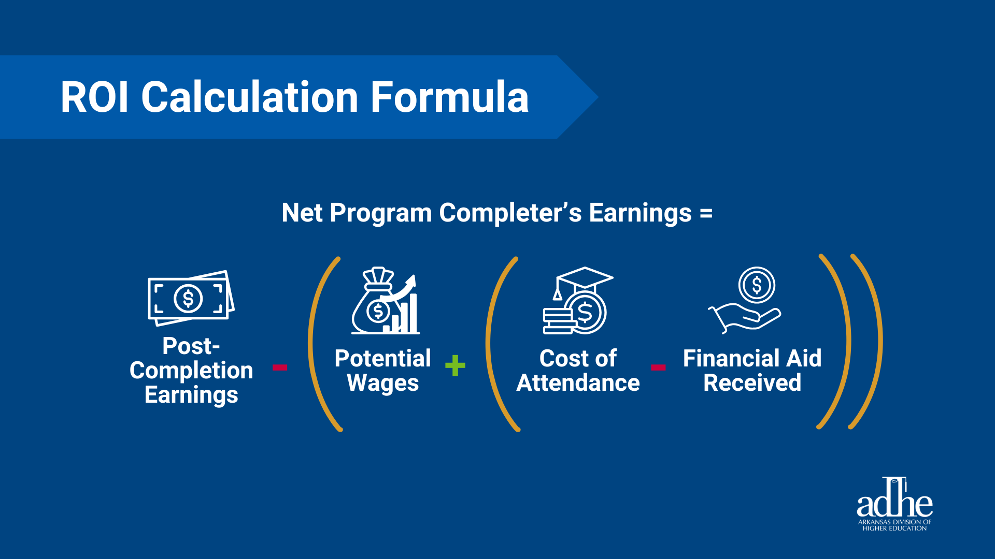

Slide 16
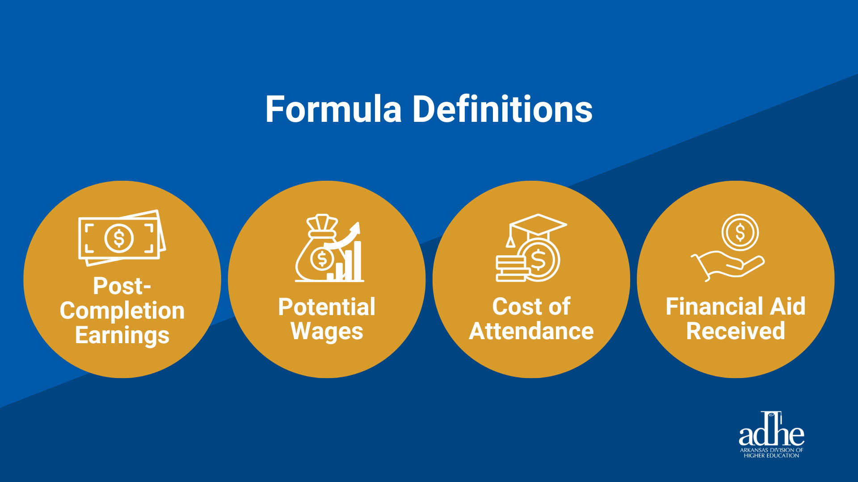

Slide 17
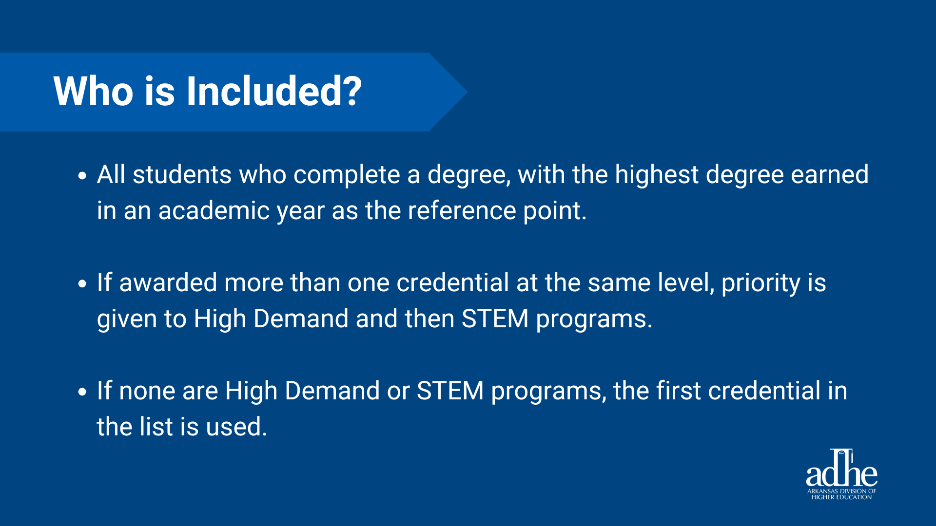

Slide 18
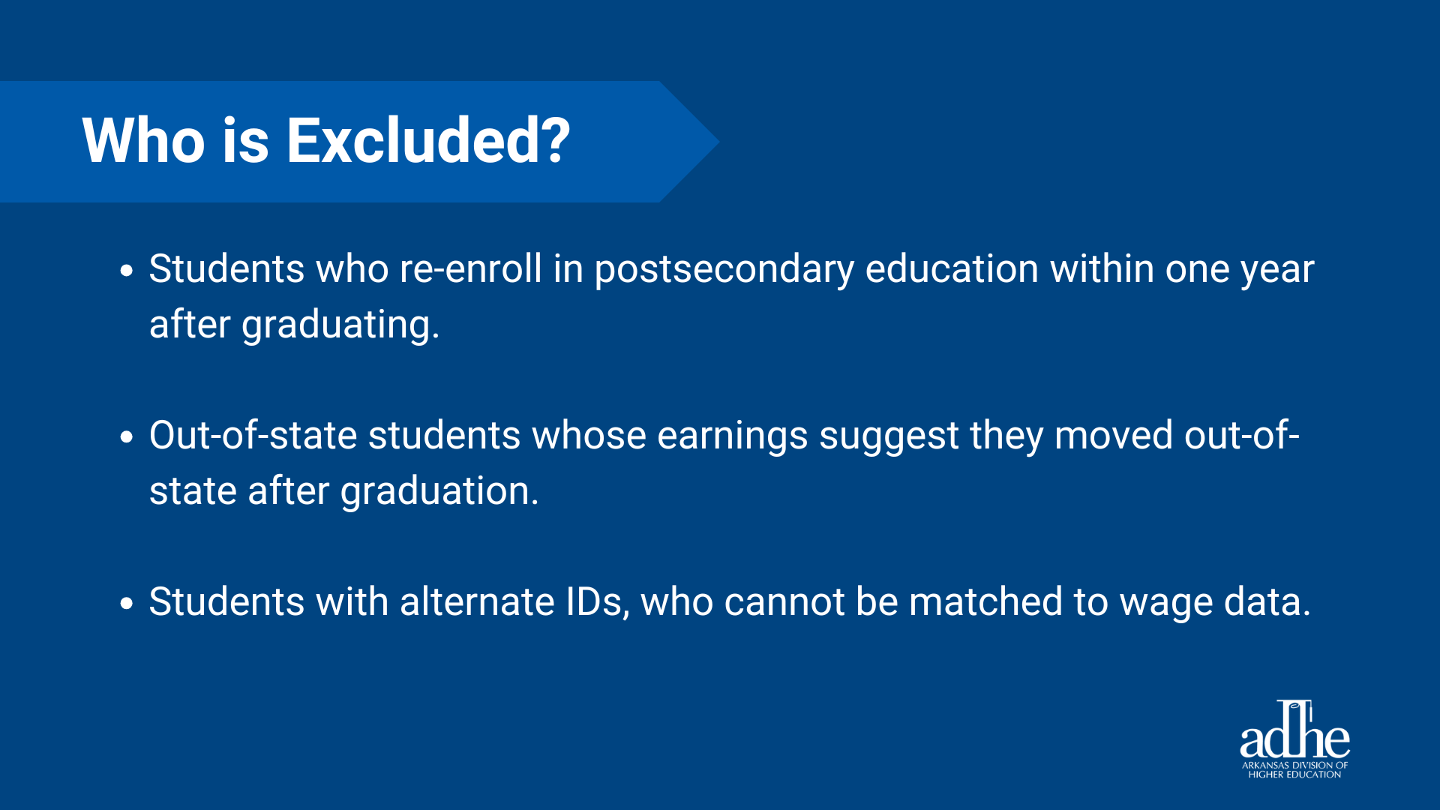

Slide 19
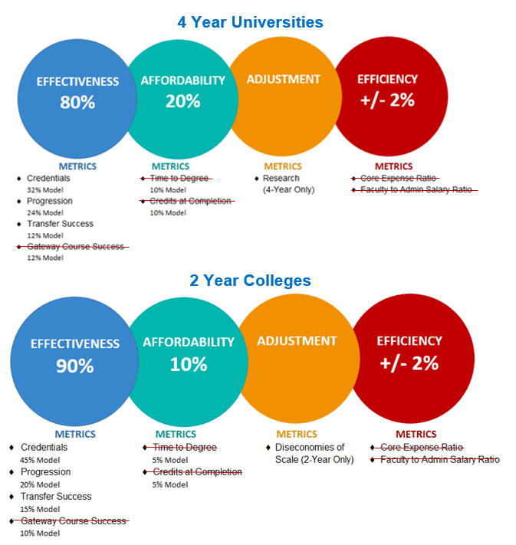
Current Productivity
Funding Formula
Red-lines represent metrics and ratios in current model that are changing in the new funding model.

Slide 20
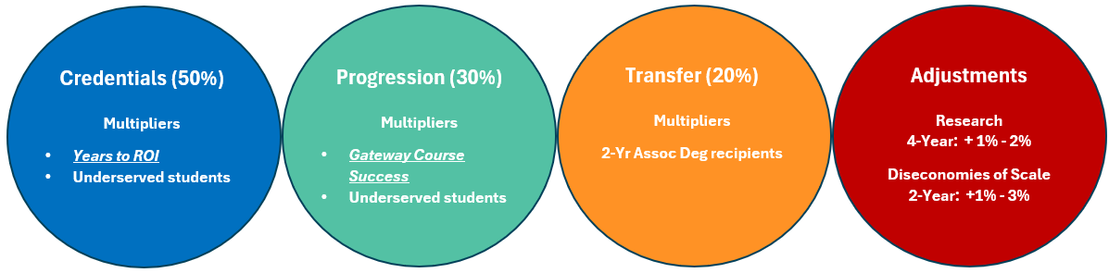
Revised Productivity
Funding Formula
Years to ROI will be a multiplier in the Credentials metric replacing the STEM and High Demand multipliers
The Gateway Course Success metric will now be a multiplier in the Progression metric

Slide 21
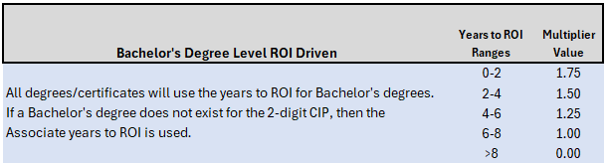
Multipliers Based on
Years to ROI

Slide 22
Value-Based Productivity
Funding Model Timeline
Both Models Ran with FY28 Recommendation based on Current Model
New Rules Drafted
FY29 Funding Recommendation based on new Model
Spring 2026
July 2026
October 2027
July 2026
Spring 2027
AHECB Approval
New Model Run for FY29 Recommendation

Slide 23
ANY QUESTIONS?

Slide 24
Dr. Ken Warden
Commissioner
AGENDA ITEM NO. 4:
ADHE UPDATES

Slide 25
NEXT MEETING
Tuesday, July 7, 2026

Slide 26
PUBLIC COMMENTS/
ANNOUNCEMENTS
Follow-up questions can be sent to: Nichole.Abernathy@adhe.edu
Presentations will be posted on the ADHE website at:
https://www.adhe.edu/about-adhe/coordinating-board/board-presentations

